Slide 1
Programming tutorial course
Dr Michael Berks
michael.berks@manchester.ac.uk
Lesson 2: calling in-built functions. Let's start working with images!

Slide 2
Calling in-built functions
Last week we saw how to create our own functions inside a Matlab or python script
This week, we'll start by learning how to call in-built functions
Matlab is super easy – just call any in-built function in the same way we called our own

Slide 3

How about python?
Python is slightly different
It won’t automatically look for functions
You need to specify which you want to use, by using the key word
    import
You can import either modules or specific functions

Slide 4
First task
Create a new folder in your programming tutorial folder called ‘data’
Download the images einstein.png and trump.png from Blackboard into ‘data’
Create new scripts:
  Matlab: programming_tutorial_lesson2_script.m
  Python: programming_tutorial_lesson2_script.py

Slide 5
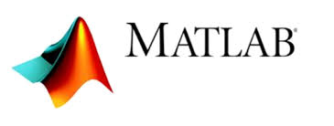
Loading and viewing images
We'll start in Matlab…
Load the images into Matlab using the commands
einstein_im = imread('data/einstein.png')
trump_im = imread('data/trump.png')
Use imshow to view both images
figure()
imshow(einstein_im)
figure()
imshow(trump_im)
What happens if we didn't call figure?

Slide 6
Now try in python
First we have to import the module pyplot using the command
import matplotlib.pyplot as plt
Load the images using the commands
einstein_im = plt.imread('data/einstein.png')
trump_im = plt.imread('data/trump.png')
Use imshow to view both images
plt.figure()
plt.imshow(einstein_im)
plt.figure()
plt.imshow(trump_im)
Note how similar the code is… that's because matplotlib is a toolbox based on Matlab's functionality. We just need to prefix each function call with plt

Slide 7
Look at your workspace
What information does it give about the variables we have created?

Slide 8
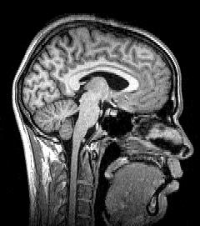
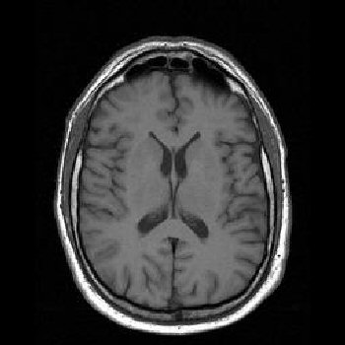

Those tutorials were dull…
… I want to do something fun with images!

Slide 9
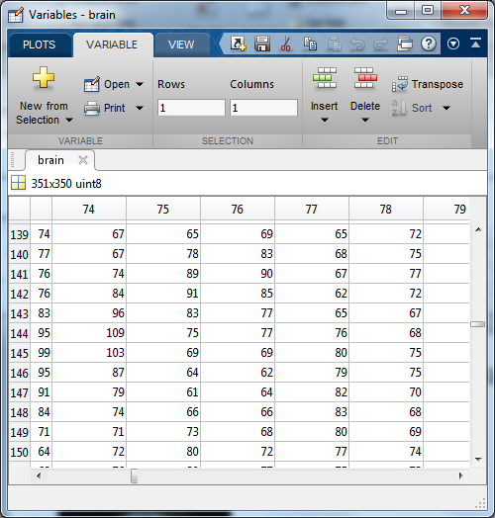
What does an image look like to a computer?
A computer ‘sees’ an image as an array of numbers…
We call each number a pixel (or in 3D a voxel)…
…. the value of each pixel represents its intensity (or colour)
liver_slice = imread(‘data\liver_slice.png’);

Slide 10
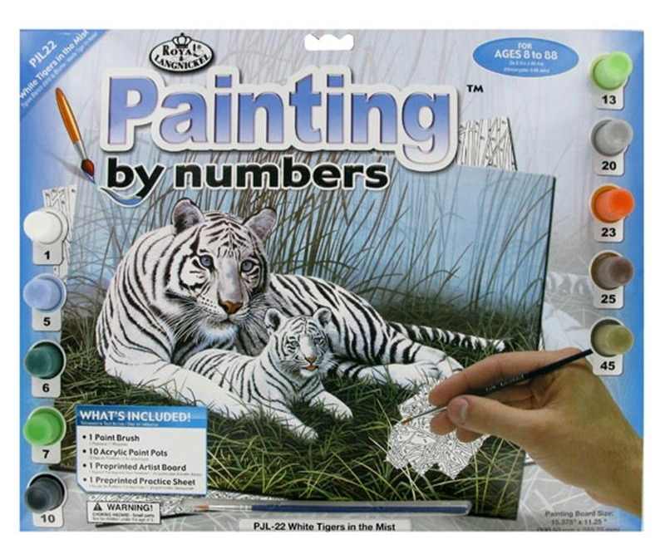

Slide 11

So to learn how to do stuff with images…
… I need to understand how to use arrays

Slide 12
Arrays
Matlab was originally designed to allow efficient and intuitive processing of vectors and matrices
Understanding how to use arrays is the key to successfully working with Matlab
Arrays not as fundamental to python, but still the way in which we store and manipulate images
Next week we’ll see more on how images in Matlab and python are just arrays of numbers

Slide 13
Python users
Need to import numpy
You may find it useful to have this tutorial open
https://numpy.org/doc/stable/user/numpy-for-matlab-users.html

Slide 14
Indexing arrays
All arrays are indexed row then column
  A = reshape(1:16, 4, 4);
We can access individual elements by
  giving row and column subscripts
    b = A(2, 3); 3rd column of the 2nd row
  giving a single index
    b = A(10)
We can access whole rows or columns using :
    b = A(2,:); b is 1x4, the 2nd row of A
    c = A(:,4); c is 4x1, the 4th column of A
We can access specific ranges
    b = A(1, 2:4); b is 1x3, the 2nd, 3rd and 4th elements of the 1st row
    C = A(2:3,2:3); C is 2x2, the middle 4 elements of A
    D = A(2:3, [1 4]); D is 2x2, the 1st and 4th elements of the 2nd and 3rd rows

Slide 15
Let's try this with our images
Use array indexing to take a copy of a rectangle from the 80th to 105th rows, and 96th to 160th columns of the Einstein image
Use imshow to look at this array – rename your variable something sensible!
Do the same for 53rd to 78th rows and 100th to 164th columns in the Trump image

Slide 16
Indexing arrays (cont.)
When accessing arrays, ‘end’ acts a special (and very useful!) keyword that refers to the size of that dimension
  A = rand(4,5);
    b = A(1, 2:end); b is 1x4, the 2nd to 5th elements of the 1st row
    c = A(2:end-1,3); c is 2x1, the 3rd column of the 2nd to 3rd rows
    d = A(1:end/2,:); d is 2x5, all columns of the first 2 rows
Try the following:
  einstein_top = einstein_im(1:end/2, :);
  trump_left = trump_im(:,1:end/2);
  einstein_bottom100 = einstein_im(end-99:end, :);

Slide 17
Let's try this in python
einstein_eyes = einstein_im[79:105, 95:160]
trump_eyes = trump_im[52:78, 99:164]
plt.figure()
plt.imshow(einstein_eyes)
plt.figure()
plt.imshow(trump_eyes)
einstein_top = einstein_im[:einstein_im.shape(0)/2,:]
trump_left = trump_im [:,:trump_im.shape(1)/2]
einstein_bottom100 = einstein_im[-100:,:]
What differences do you notice?

Slide 18
Key differences in python numpy…
Indexing
  Starts at 0
  The end of an index is range is exclusive, eg: 0:3 -> 0, 1, 2
  Use [] instead of ()
  Don’t use end keyword
    Leave empty to index to end of dimension
    Use –idx to index from end

Slide 19
Indexing arrays - assigning
We can also use indexing on the LHS of equations to assign parts of an array
  A = zeros(5,5); B = rand(4,4);
  Either with an array of the same size
    A(1:4,1:4) = B;
    A(3:5,4:5) = B(1:3,1:2);
    A(3:5,4:end) = B(1:3, [1 4]);
    A([1 5 9]) = B([2 4 11]);
    A(1:4,1:3) = B; Causes an error! Why?
  Copy back to the same variable
    B(1,:) = B(4,:); Copies the 4th row of B to its 1st row (the values of which are now lost!)
  Or with a scalar
    A(:,2) = 0; Sets the 2nd column of A to zero
    B([1 4 15]) = pi; Sets the 1st, 4th and 15th elements of B to π

Slide 20
Out-of-bounds indexing
If we try and access an element using an index larger than the dimensions of an array, we get an out-of-bounds error
  A = rand(5,5);
    b = A(5,6);
    b = A(26);
    b = A(end+1,2);
If we assign to out-of-bounds indices, Matlab automatically extends the target array
    A(5,6) = 1; A is now 5x6
    A(end+3,2) = 2; A is now 7x6
    A(:,end+1) = rand(7,1); A is now 7x7
Negative numbers, zeros, and non-integers can never be used, either accessing or assigning
  (Except in the special case of logical indexing – we’ll cover later!)

Slide 21
Let's try this with our images
Using array assignment, copy “The Donald”’s eyes into Einstein’s. Look at the result!
  einstein_im_copy = einstein_im;
  einstein_im_copy(80:105, 96:160) = trump_eyes;
Do the same to copy Eintein's eyes into the trump image

Slide 22
Let's try this in python
einstein_im_copy = einstein_im
trump_im_copy = trump_im
einstein_im_copy[79:105,95:160] = trump_eyes
trump_im_copy[52:78,99164] = einstein_eyes
What went wrong?

Slide 23
Try again using np.copy…
einstein_im = plt.imread('data/einstein.png')
trump_im = plt.imread('data/trump.png')
einstein_im_copy = np.copy(einstein_im)
trump_im_copy = np.copy(trump_im)
einstein_eyes = einstein_im[79:105, 95:160]
trump_eyes = trump_im[52:78, 99:164]
einstein_im_copy[79:105,95:160] = trump_eyes
trump_im_copy[52:78,99164] = einstein_eyes

Slide 24
Key differences in python numpy…
Array slices give us a "view" of the original. Need to take explicit copy to avoid overwriting original
Can’t dynamically extend size of arrays
Arrays have a specific dimension
  e.g. a 1-D array is a different type to a 2D-array
  Always index dimensions separately

Slide 25
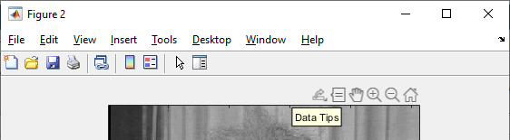
Extended exercises?
Can you do swap Einstein and Trump's mouths? Hint, in Matlab you can use the pixel pointer tool to work out which rows and columns to use
Can you use array indexing to make a copy of the images half the size? Hint: try the pattern 1:2:n in Matlab
Can you use array indexing to flip the images upside-down or left-to-right? Hint: try the pattern n:-1:1 in Matlab
Does this work in python too?
Click on this button, then click anywhere in the image

Slide 26
Homework exercise
From blackboard, save the script array_indexing.m into your Matlab scripts folder from
  Open the script
Copy and paste each line (or highlight and press F9) to run each line at the command line
Do all the examples make sense?
Which lines generate errors? Why?
Try the same in python with array_indexing.py

